Slide 1


arXiv--2019
Google VPS
Large-scale, real-time visual-inertial localization revisited
康 腾
2019.12.01

Slide 2

Content of report
Part 1. Google VPS
Part 2. Large-scale, real-time visual-inertial localization
Part 3. 结论

Slide 3
Content of report
Part 1. Google VPS
Part 2. Large-scale, real-time visual-inertial localization
Part 3. 结论

Slide 4
Google VPS
Google I/O 2017发布的VPS全称是Visual Positioning Service，建立在Google Tango和Google地图之上。
• Localization
• Mapping

Slide 5
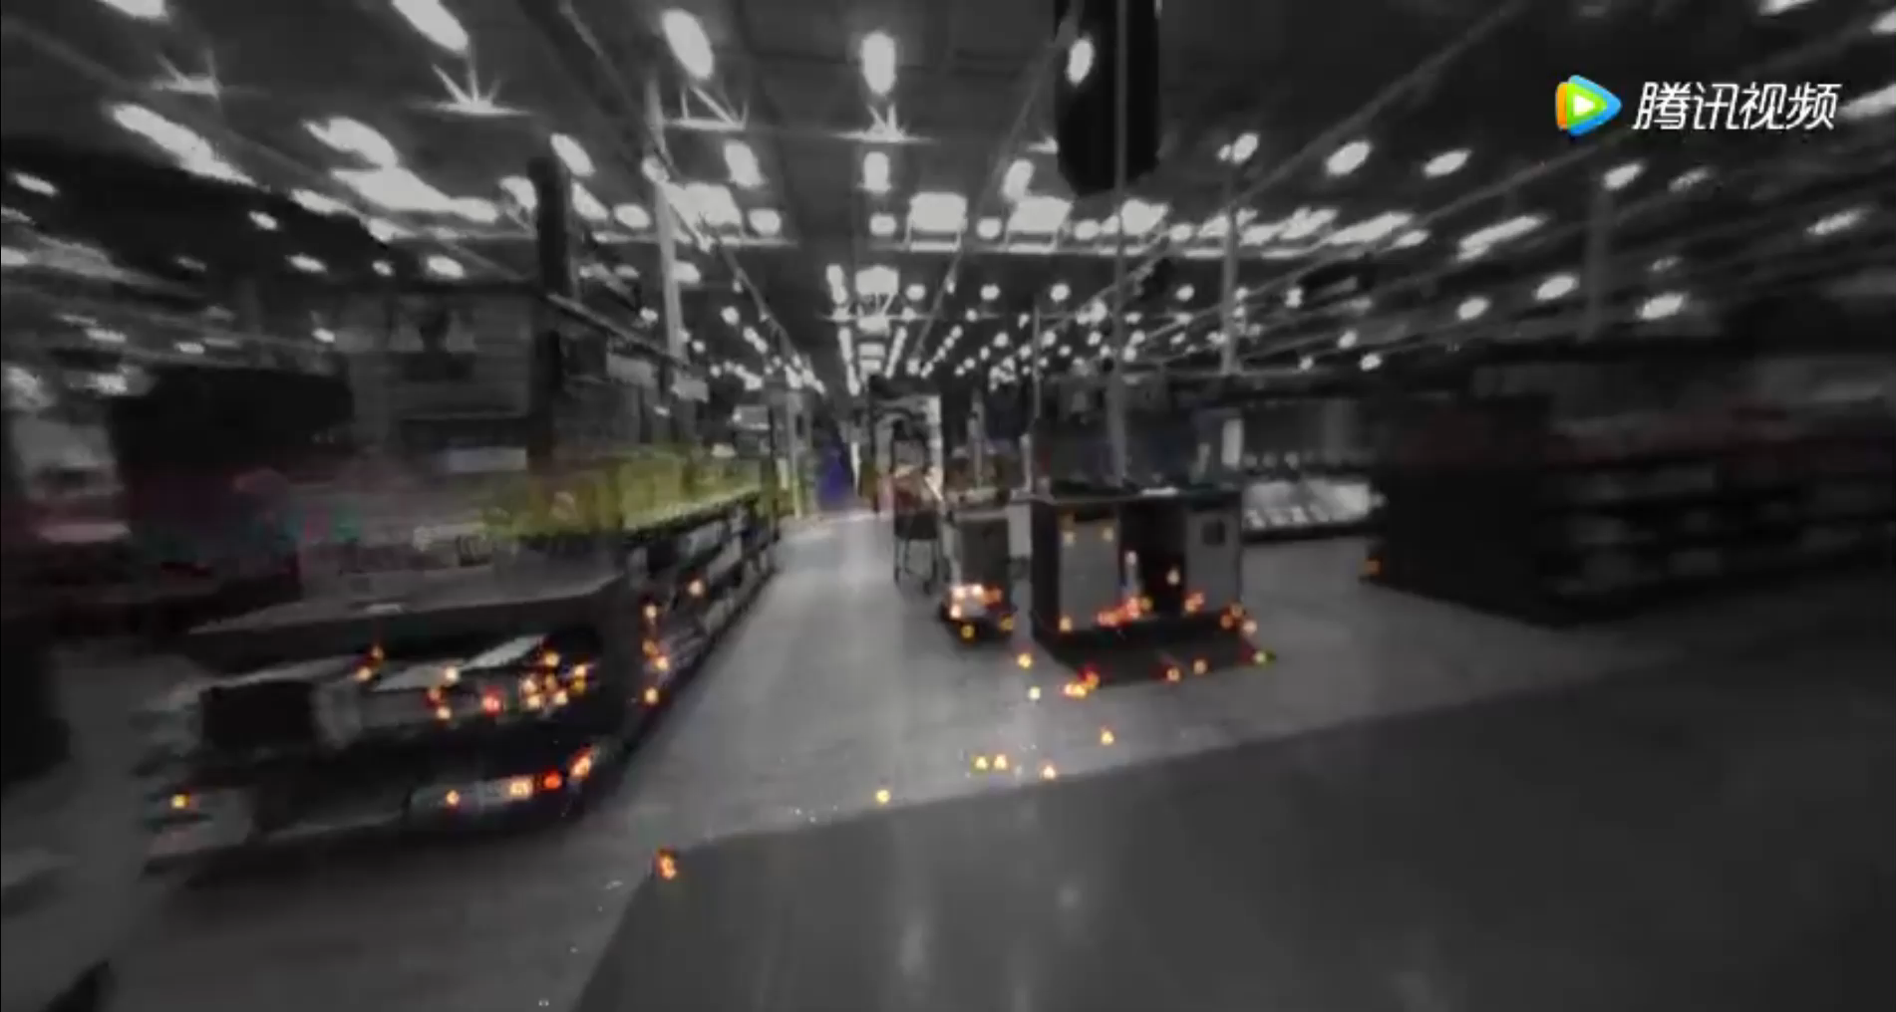
Google VPS
• Google VPS

Slide 6
Content of report
Part 1. Google VPS
Part 2. Large-scale, real-time visual-inertial localization
Part 3. 结论

Slide 7
Large-scale, real-time visual-inertial localization revisited
论文分享
2019 arXiv :
Lynen S, Zeisl B, Aiger D, et al. Large-scale, real-time visual-inertial localization revisited[J]. arXiv preprint arXiv:1907.00338, 2019.

Slide 8
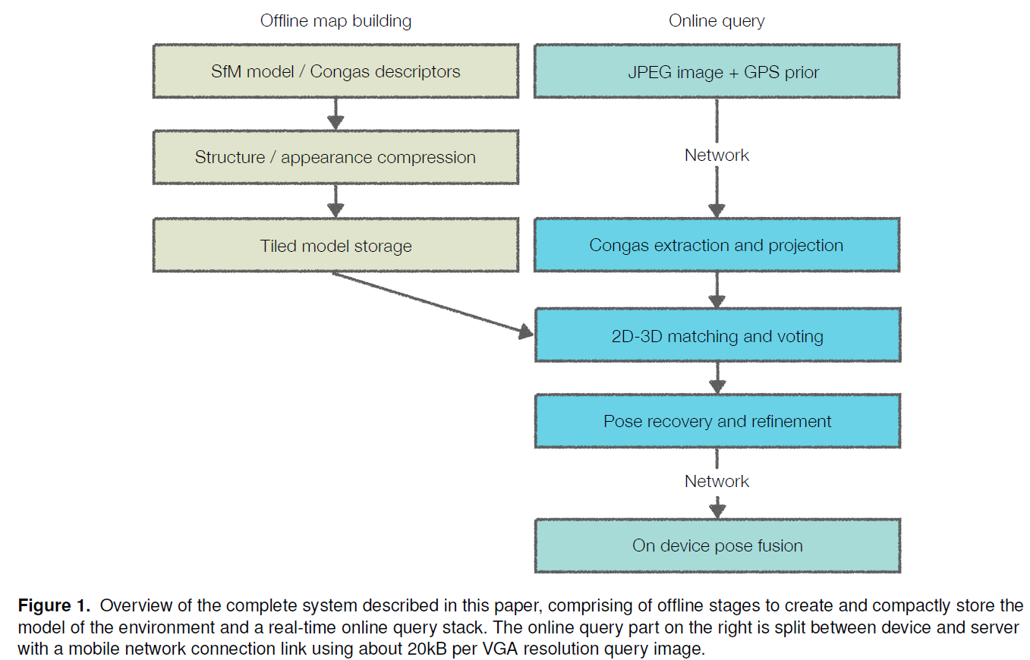
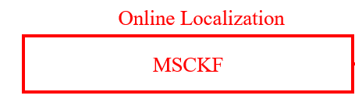
Large-scale, real-time visual-inertial localization revisited

Slide 9
Large-scale, real-time visual-inertial localization revisited
Input: Camera, GPS，LiDAR，odometry and inertial sensors
Location:Paris, Tokyo, Zurich and San Francisco
Data Size: about 100,000 3D points and 200,000 to 500,000
visual descriptors(after compression)
mobile platforms:BRIEF，ORB，FREAK and BRISK
large scale scenes：SIFT，SURF and CONGAS

Slide 10
Large-scale, real-time visual-inertial localization revisited
A typical model:1M 3D points for an area of 20000 m² require between 500 MB and 800 MB
a medium-sized city: several tens of TB of storage
Structure Summarization: ILP-optimization
Appearance Summarization:k-means clustering
Appearance Compression:Product Quantization, vocabulary

Slide 11
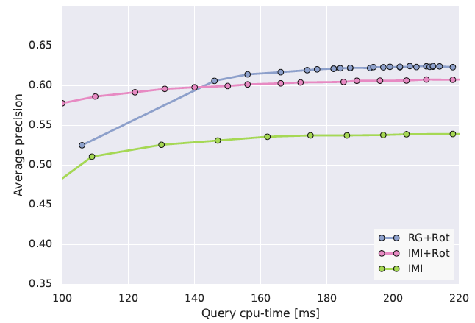
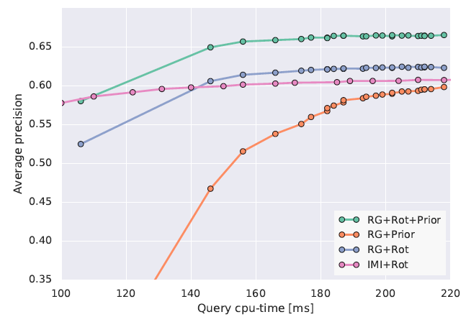
Large-scale, real-time visual-inertial localization revisited
accelerate :kd-tree, The inverted multi-index, Random Grids

Slide 12
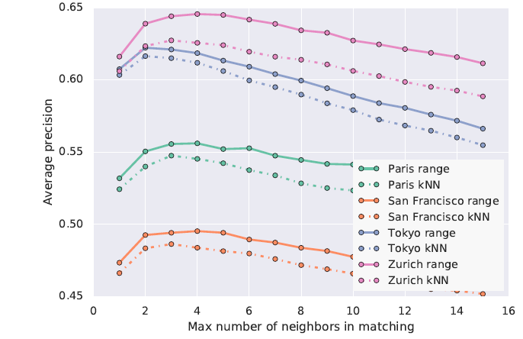
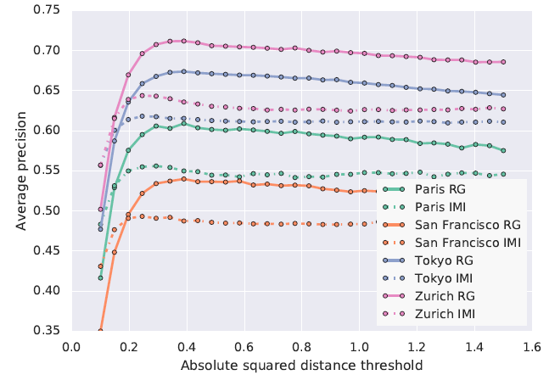
Large-scale, real-time visual-inertial localization revisited
Outlier Filtering:Range Search, kNN and Thresholding

Slide 13
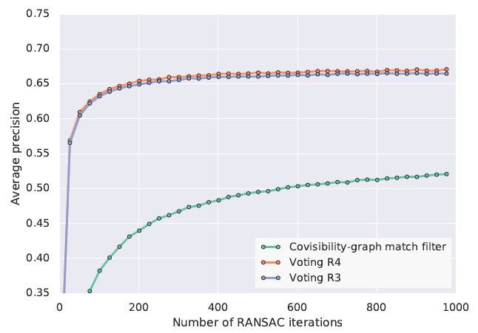
Large-scale, real-time visual-inertial localization revisited
Outlier Filtering:Co-Visibility-Based and Geometric, voting

Slide 14
Large-scale, real-time visual-inertial localization revisited
Camera Pose Estimation:
randomized RANSAC+PNP
Pose Candidate Refinement:
a voting scheme+weight this score with the pose prior

Slide 15
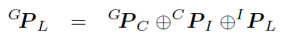
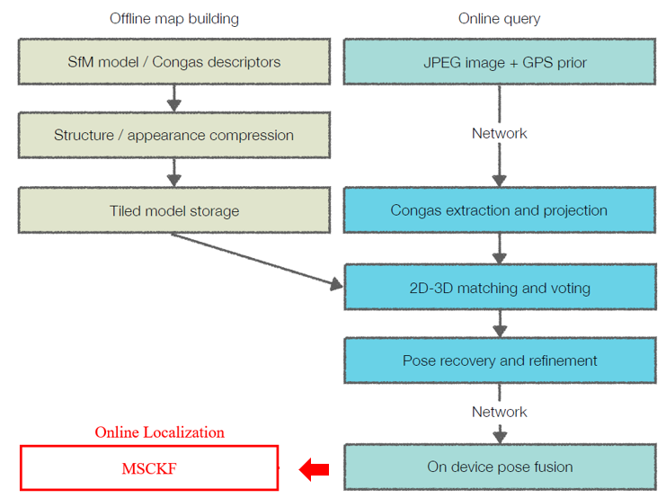
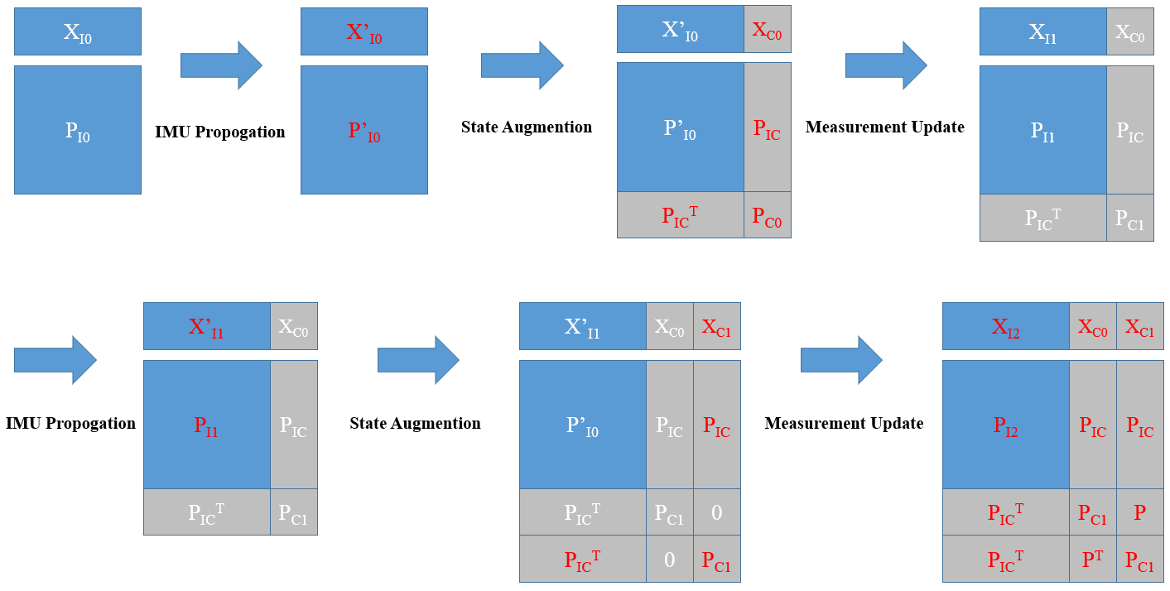
Large-scale, real-time visual-inertial localization revisited

Slide 16
Content of report
Part 1. Google VPS
Part 2. Large-scale, real-time visual-inertial localization
Part 3. 结论

Slide 17
结论
Conclusion：
在本文中，我们提出了一个大规模的视觉定位系统。我们提供了有关地图压缩和定位算法的详细信息，这些细节对于地图在服务器端的部署至关重要。
我们还展示了定位系统中各种参数的影响，包括对异常过滤策略的新颖见解，这些异常过滤策略允许查询的延迟范围为200ms。通过添加改进的描述子匹配算法，位置优先和候选优化步骤，我们发现该系统优于其他大规模模型时使用的方法。
我们通过查询使用智能手机相机收集的250万张图像，评估了该系统在三大洲四个城市中的验证情况。模型的规模和查询数量比以前的评估高出几个数量级，并有望证明参数选择的广泛适用性。

Slide 18

Thank you for your
listening and guidance ！

